Slide 1
Mixing-PowerDAC
17-12-2015

Slide 2
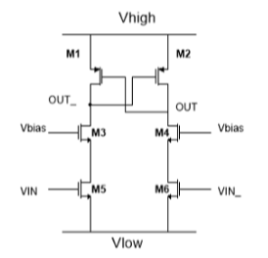
Levelshifter(1)
ThinOx
W_{M5-6}= 200 nm
L_{M5-6} = 50 nm
ThickOx
W_{M3-4-5-6} = 1 um
L_{M3-4-5-6} = 300 nm

Slide 3
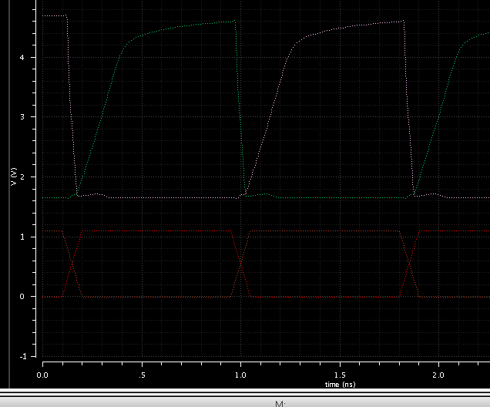
Levelshifter(2)

